Slide 1
CSE514 – Datamining Fall 2022 Regression
Cynthia Ma
Department of Computer Science
Washington University in St. Louis
czma@wustl.edu

Slide 2
Quick admin follow-up
Access to Canvas, Piazza, and Gradescope
Office hours this Friday, 2-3pm
Zoom link through Canvas calendar
In-person at Urbauer 226

Slide 3
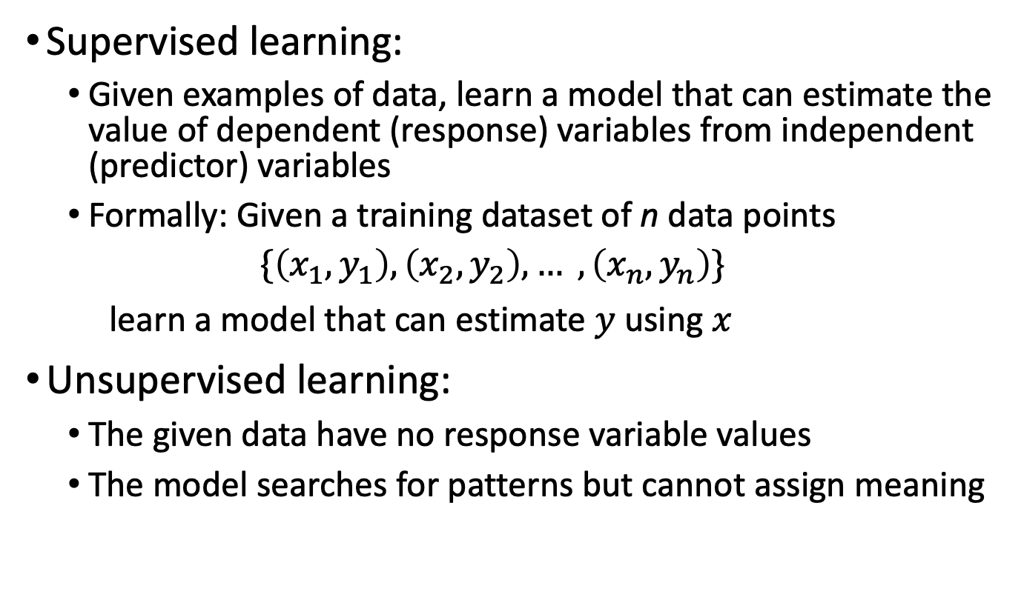
How does a model learn?
Supervised learning:
Given examples of data, learn a model that can estimate the value of dependent (response) variables from independent (predictor) variables
Formally: Given a training dataset of n data points
$$\{\left(x_{1},y_{1}\right),\left(x_{2},y_{2}\right), … ,\left(x_{n},y_{n}\right)\}$$
learn a model that can estimate $y$ using $x$
Unsupervised learning:
The given data have no response variable values
The model searches for patterns but cannot assign meaning

Slide 4
Supervised learning goals
We want to predict a discrete class label
Classification problem
We want to predict a continuous quantity value
Regression problem
The input (predictor) variable types do not matter
Algorithms used to address one type of problem can often be adjusted to address the other

Slide 5
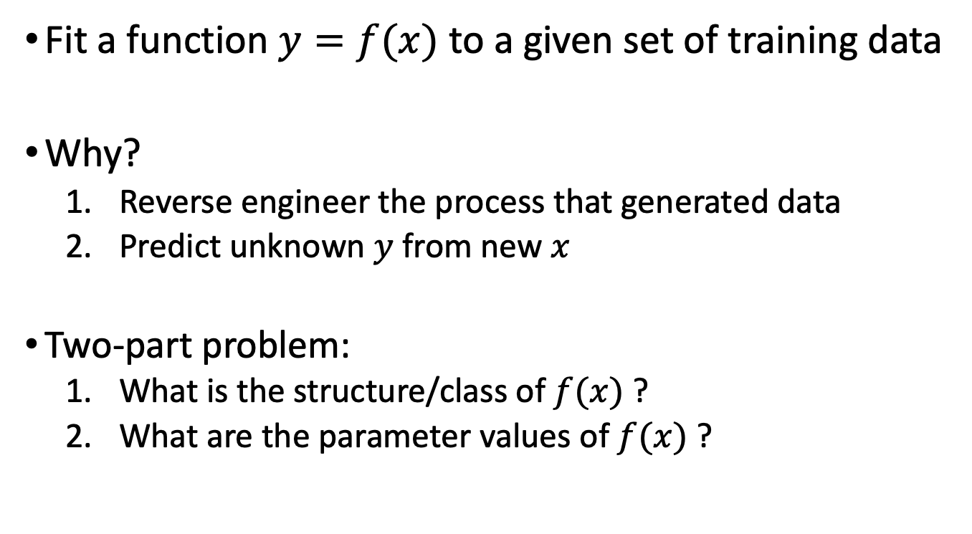
Regression algorithms
Fit a function $y=f(x)$ to a given set of training data
Why?
Reverse engineer the process that generated data
Predict unknown $y$ from new $x$
Two-part problem:
What is the structure/class of $f(x)$ ?
What are the parameter values of $f(x)$ ?

Slide 6
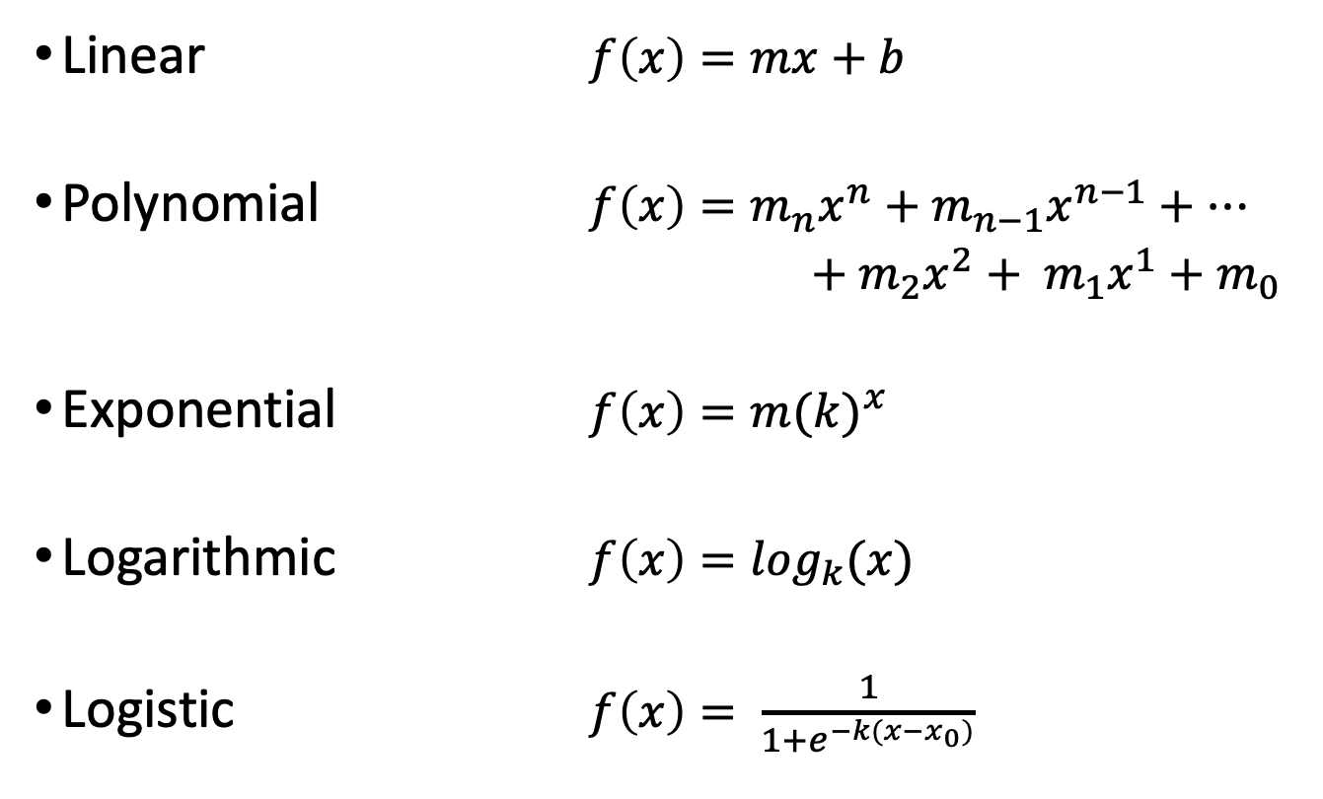
Function classes
Linear $f\left(x\right)=mx+b$
Polynomial $f\left(x\right)=m_{n}x^{n}+m_{n−1}x^{n−1}+…$
$+ m_{2}x^{2}+ m_{1}x^{1}+m_{0}$
Exponential $f\left(x\right)=m{(k)}^{x}$
Logarithmic $f\left(x\right)=\log_{k}(x)$
Logistic $f\left(x\right)= \frac{1}{1+e^{−k(x−x_{0})}}$

Slide 7
How do we pick a function class?
Search the function space
Computationally intractable
Domain knowledge
Can be limiting
Visual inspection of data
Data driven, but complicated by high dimensionality

Slide 8
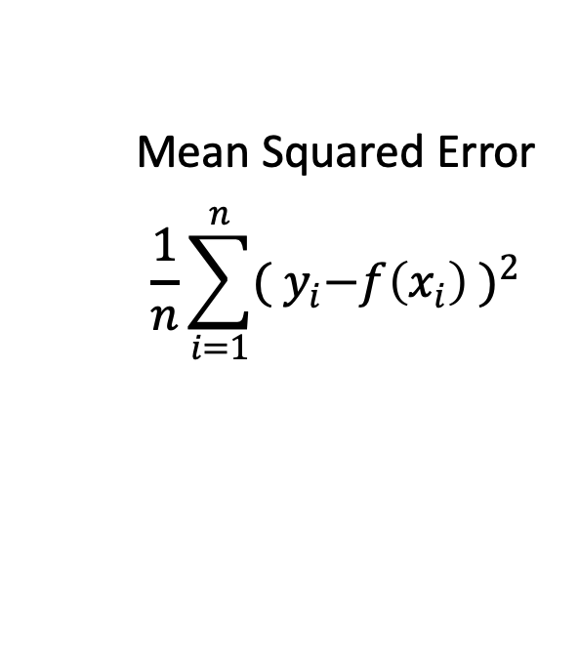
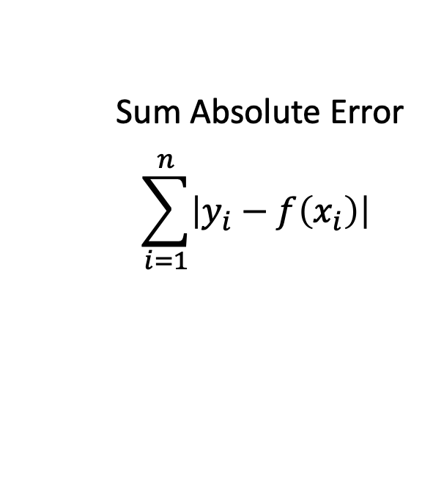
How do we pick parameter values?
The goal is to minimize the difference between observed response variables and the model’s estimated values
Define an objective (or loss) function
Sum Absolute Error
$$\sum_{i=1}^{n}{\left|y_{i}−f\left(x_{i}\right)\right|}$$
Mean Squared Error
$$\frac{1}{n}\sum_{i=1}^{n}{{{( y}_{i}−f\left(x_{i}\right) )}^{2}}$$

Slide 9
How do we interpret the results?
We fit a multi-variate linear function to predict the prices of people’s lunch from five other variables
{hot, cold}
Weight in grams
{take-out, delivery, dine-in, home-made}
Food culture
Number of ingredients
The output includes:
How well the model fit the data
Parameter values for each predictor variable

Slide 10
Gradient descent
How do we optimize the objective function?
The metaphor:
You are lost at night and need to find water
Each time you take a step, you change your location along the North/South axis and the East/West axis
At your current location, you can feel the slope of the hill under your feet
You don’t know the coordinates of the water, but you do know it’s likely at the lowest point

Slide 11
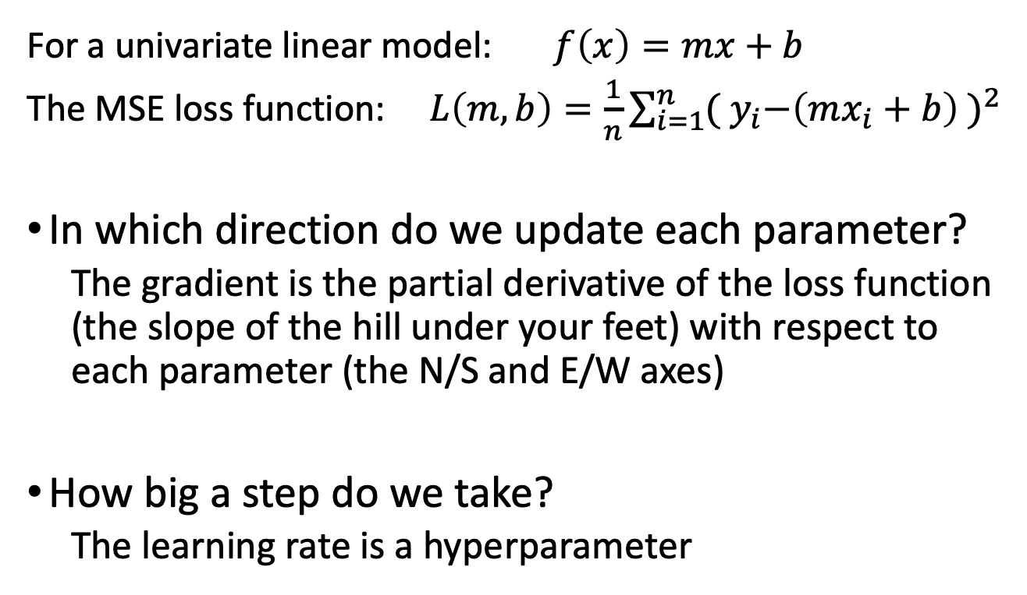
Steps in gradient descent
For a univariate linear model: $f\left(x\right)=mx+b$
The MSE loss function: $L\left(m,b\right)=\frac{1}{n}\sum_{i=1}^{n}{{{( y}_{i}−\left(mx_{i}+b\right) )}^{2}}$
In which direction do we update each parameter?
The gradient is the partial derivative of the loss function (the slope of the hill under your feet) with respect to each parameter (the N/S and E/W axes)
How big a step do we take?
The learning rate is a hyperparameter

Slide 12
When do we stop?
We’ve reached the theoretical minimum of the objective function (we found the bottom of the hill)
We’ve reached a maximum number of search steps (we’re exhausted before finding the bottom)
We’ve stopped updating the objective function by significant amounts (the slope has flattened)

Slide 13
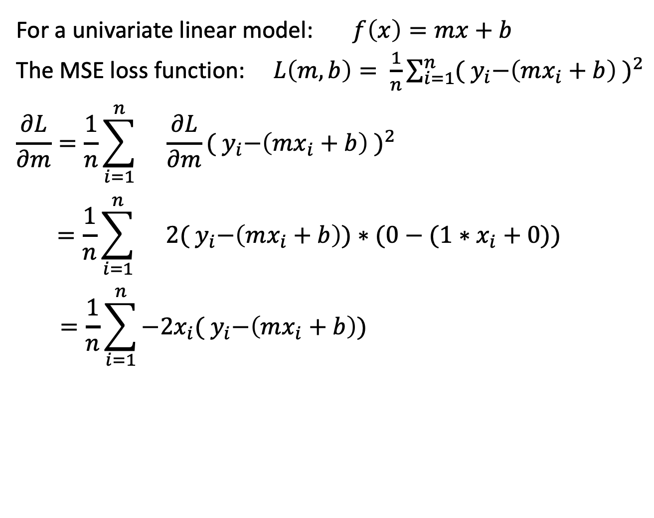
Partial derivative
For a univariate linear model: $f\left(x\right)=mx+b$
The MSE loss function: $L\left(m,b\right)= \frac{1}{n}\sum_{i=1}^{n}{{{( y}_{i}−\left(mx_{i}+b\right) )}^{2}}$
$$\frac{∂L}{∂m}=\frac{1}{n}\sum_{i=1}^{n}{}{\frac{∂L}{∂m}{( y}_{i}−\left(mx_{i}+b\right) )}^{2}$$
$$=\frac{1}{n}\sum_{i=1}^{n}{}2{( y}_{i}−\left(mx_{i}+b\right))∗(0−(1∗x_{i}+0))$$
$$=\frac{1}{n}\sum_{i=1}^{n}{−2x_{i}{( y}_{i}−\left(mx_{i}+b\right))}$$
HW1 Extra Credit:
Calculate the partial derivative of parameter b

Slide 14
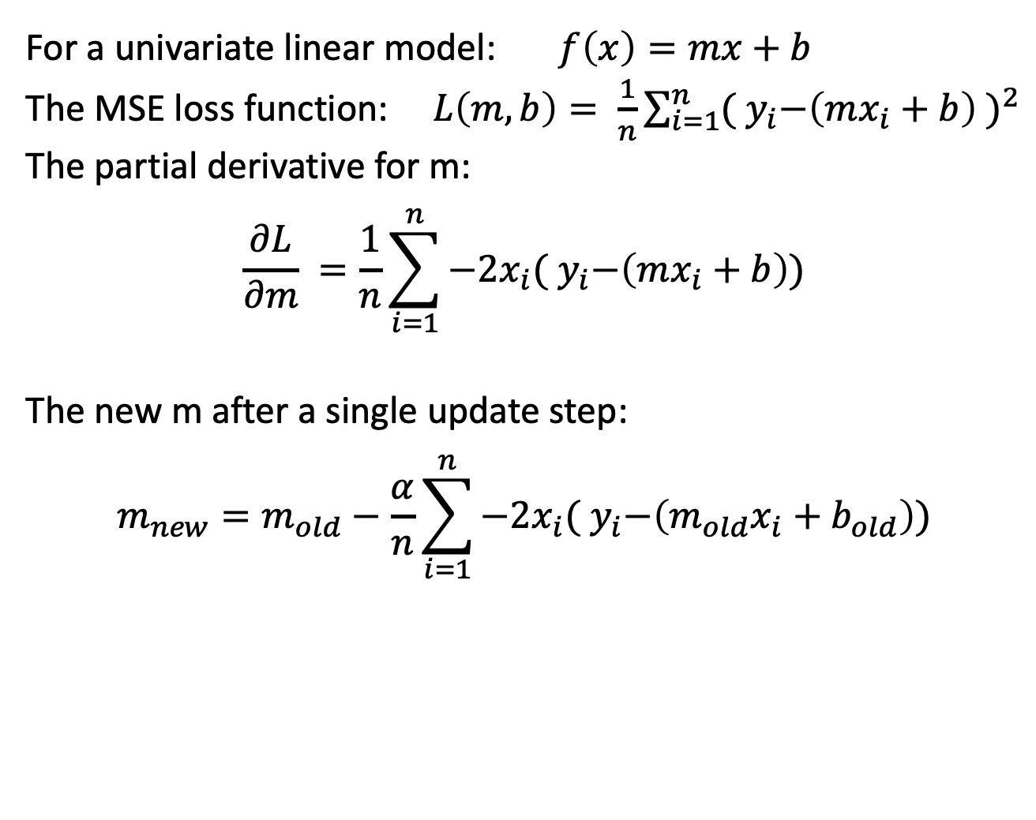
Taking a step
For a univariate linear model: $f\left(x\right)=mx+b$
The MSE loss function: $L\left(m,b\right)= \frac{1}{n}\sum_{i=1}^{n}{{{( y}_{i}−\left(mx_{i}+b\right) )}^{2}}$
The partial derivative for m:
$$\frac{∂L}{∂m} =\frac{1}{n}\sum_{i=1}^{n}{−2x_{i}{( y}_{i}−\left(mx_{i}+b\right))}$$
The new m after a single update step:
$$m_{new}=m_{old}−\frac{α}{n}\sum_{i=1}^{n}{−2x_{i}{( y}_{i}−\left(m_{old}x_{i}+b_{old}\right))}$$

Slide 15
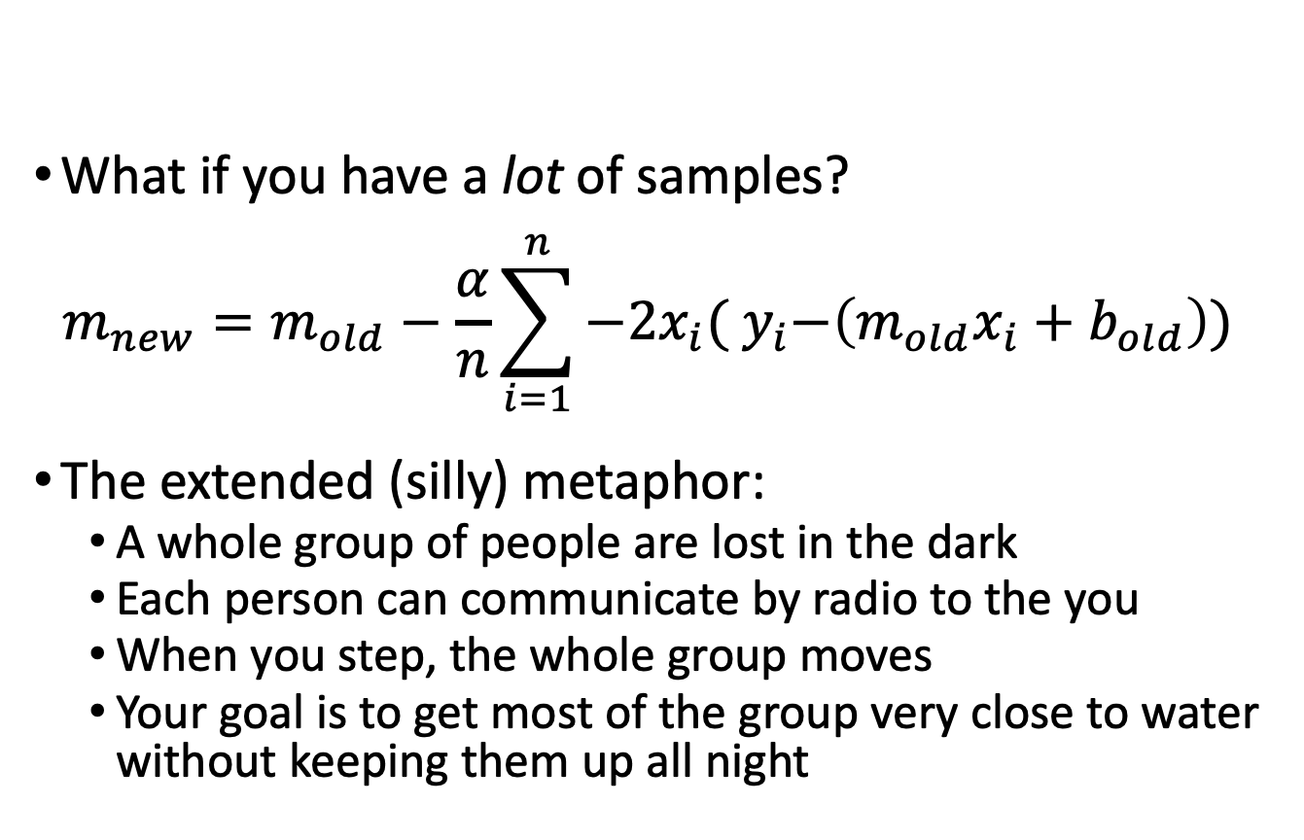
Stochastic gradient descent
What if you have a lot of samples?
$$m_{new}=m_{old}−\frac{α}{n}\sum_{i=1}^{n}{−2x_{i}{( y}_{i}−\left(m_{old}x_{i}+b_{old}\right))}$$
The extended (silly) metaphor:
A whole group of people are lost in the dark
Each person can communicate by radio to the you
When you step, the whole group moves
Your goal is to get most of the group very close to water without keeping them up all night

Slide 16
Overfitting
We fit a model to the training data, but it cannot predict the response values for new data
The model cannot be used for prediction
Can the model be used to explain the training data?
Cross-validation:
Randomly divide the known data into training/testing sets
Is a model fit to the training data still able to predict the testing data?

Slide 17
Regularization
Overfitting is often attributed to overly complex models
Penalize model complexity by adding a penalty term to the objective function
LASSO regression = regression + L1 norm of the parameter vector
Ridge regression = regression + L2 norm of the parameter vector

Slide 18
Review
Supervised vs Unsupervised learning
Regression
Gradient descent
Overfitting and Regularization

Slide 19
Homework
Sign up on Piazza
Submit HW 0: Course Questionnaire
HW 1 will release at 4pm
Due next Tuesday, September 6, at midnight
Download the “freeze” version of dataset from Canvas

